Slide 1

Hispanic Health and Wellbeing in NYC
CADES Consulting:
Jonathan Anania, Destiny Stepp, Belen Ruiz, Joshua Golconda

Slide 2
Project Overview
01
02
03
Data Background
Goals
Variables of Interest
04
05
06
Modeling
Conclusion
Future Improvements

Slide 3

Data Background
01
Community Health Survey
The Community Health Survey is conducted yearly by the New York City Health department to track health of the New York City populations. We will be focusing on the 2020 dataset.
02
Collection Methods
The survey is a questionnaire that can be taken in Chinese, Spanish, Russian, and English. It can be taken either via phone call, online, or on paper.
03
Short vs Long Form
This dataset has two different versions of the survey. Different questions are found in each of the two surveys, and our findings being from the shorter version only.
Notes:
What is the Hispanic Health Paradox?
Self reported

Slide 4
Initial Goal:
Data limitation:
New Goal:
*In Epidemiology, the Hispanic Health Paradox refers to the Hispanic population having lower mortality rates than non-Hispanic whites despite in general having less access to healthcare, lower average income and education, and higher incidences of cardiovascular disease and diabetes.
Utiliza data analytics and statistical modelling to determine whether or not the Dominican population in NYC adheres to or violates the “Hispanic Health Paradox”.*
Multiple variables for assessing the Dominican population of NYC are locked behind a Data Use Agreement. No mortality variable present in the set.
Examine both physical and mental health of Hispanics in NYC to determine whether or not there are health disparities present in the Hispanic population.
Notes:
Continue exploring differences in CHS and ACS.
In Epidemiology, the Hispanic Health Paradox refers to the Hispanic population having lower mortality rates than non-Hispanic whites despite in general having less access to healthcare, lower average income and education, and higher incidences of cardiovascular disease and diabetes.

Slide 5
Variables of Interest
Mental Health:
K6 - Kessler Psychological Distress Scale measures the psychological distress experienced in the last 30 days
NSPD - Serious psychological distress, based on if the K6 score reached above the 13+ threshold
Social Health:
Trustkeys - Trusts keys with at least one neighbor.
Proudneigh - Proud of neighborhood.
Discussissues - Willing to discuss common issues with neighbors.
Helpcommproj - Willing to help community projects.
Didntcleandog - Willing to confront neighbor for not cleaning up after dog.
Physical Health:
Diabetes20 - Whether or not the respondent has been told by a healthcare professional they have Diabetes.
Toldbp20 - Whether or not the respondent has been told by a healthcare professional that they have high blood pressure.
Everasthma - Has the respondent ever been told by a healthcare professional they have asthma.
Evercopd - Has the respondent ever been told by a healthcare professional that they have COPD.
Notes:
Variables of interests are the variables we used for the outcomes of statistical models

Slide 6
Modeling Techniques
3.
K-means Clustering
Unsupervised Machine Learning method to group unlabeled data into “K” distinct groups
1.
Linear Regression
4.
Quantile Regression
Model continuous outcomes (e.g., K6 distress score, BMI) as a function of race/ethnicity and socioeconomic variables
Models the effect of certain variables at specific points in the distribution, rather than just the average.
2.
Logistic Regression
5.
Tree Regression
Model uses is a supervised machine learning algorithm that is used to predict the probability of a categorical outcome.
Recursively splits data into smaller distinct groups and predicts a continuous numerical value for new observations

Slide 7
Poverty Status by Race/Ethnicity
Method: Four survey-weighted logistic regression
Reference group: White, non-Hispanic
Controls: Age, sex, education, employment status, marital status, & nativity
Poverty Level | Hispanic Odd Ratio (95% CI)
<100% | 1.73 - 3.15
<200% | 1.57 - 2.47
<400% | 2.05 - 3.27
<600% | 2.02 - 3.54
Notes:
Lower income poverty categories

Slide 8
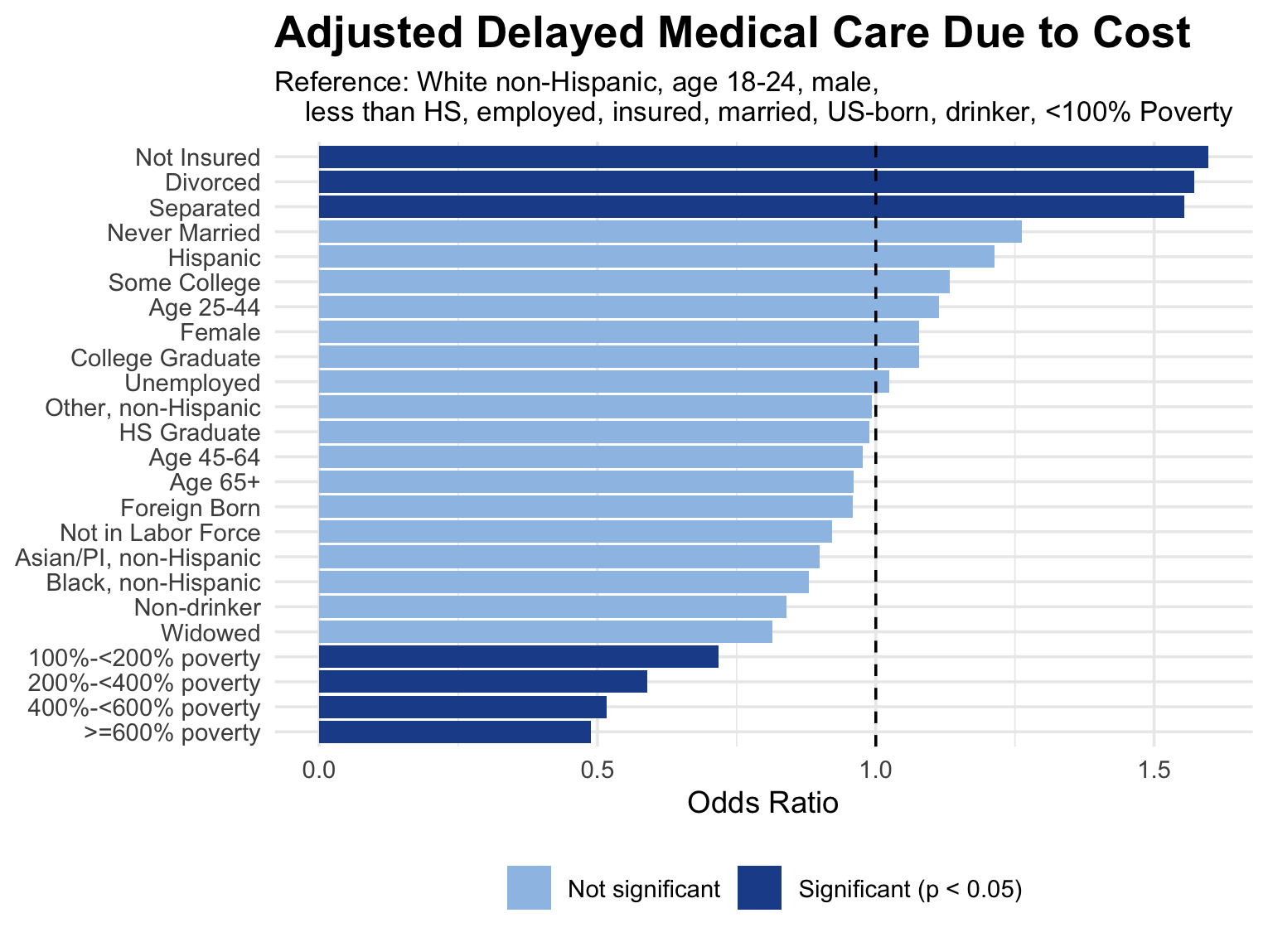
Health Care Access
Separated, divorced, and not insured were all statistically significant predictors.
Hispanics reported delayed medical care around 34% of the time, but not statistically significant.
Poverty levels were one of the strongest predictors.
Race, age, sex, employment status, drinker status, education, & nativity were all insignificant.

Slide 9
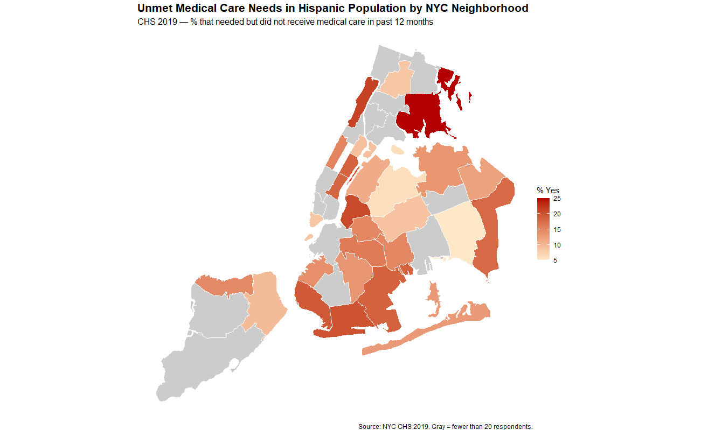
Neighborhood Most Affected:
Borough:
Bronx
Neighborhood:
Pelham - Throgs Neck
% of Hispanic Residents Not Receiving Medical Care Needed in Last 12 Months:
~25%
**UHF neighborhood codes blocked in 2020 data, 2019 data used.

Slide 10
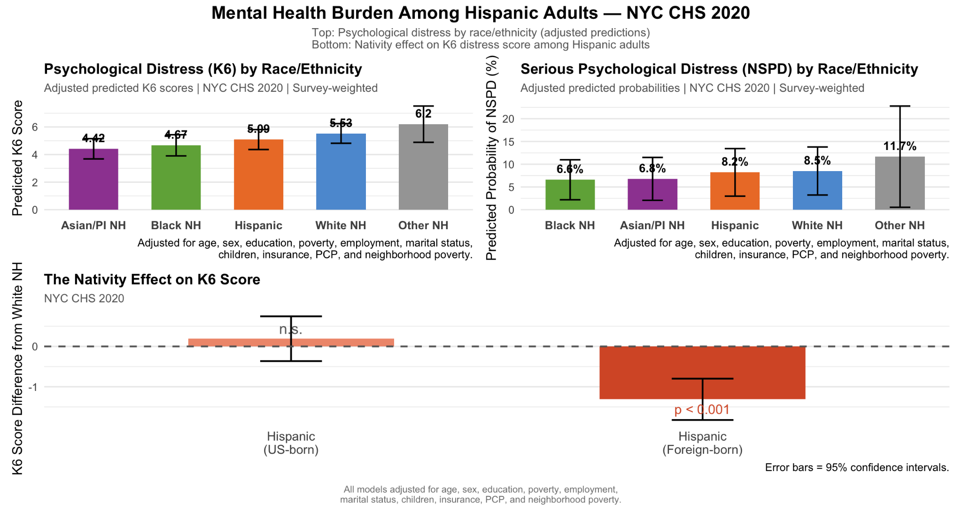
Mental Health
Notes:
K6 rates:
Hispanic group shows lower K6 scores than the white and other populations
Significant predictors - Age 65+, Income
NSPD rates:
Hispanic group had 50% higher odds of nspd, but was not significant
Significant - Female, Income
K6 nativity effect:
Us born hispanics are not significant and showed the same rate as white respondents
Foreign born hispanics have significantly lower K6 scores

Slide 11
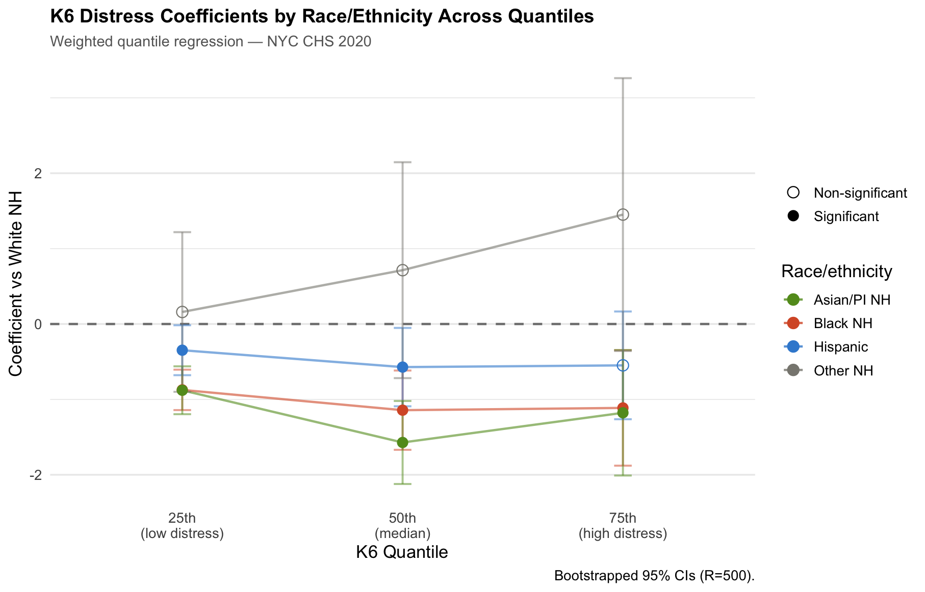
Mental Health
Hispanic
25th percentile; Hispanic has a lower K6 score than the white respondents with low K6 scores
50th percentile; Hispanic respondents has a lower K6 score than white respondents with median K6 scores
75th percentile; Hispanic respondents were non-significant but still has an lower score than the white respondents
Other groups
The other respondents were non significant on all percentile points
Black and Asian respondents report better K6 scores than the hispanic and Other groups
Notes:
Ran an quantile regression,

Slide 12
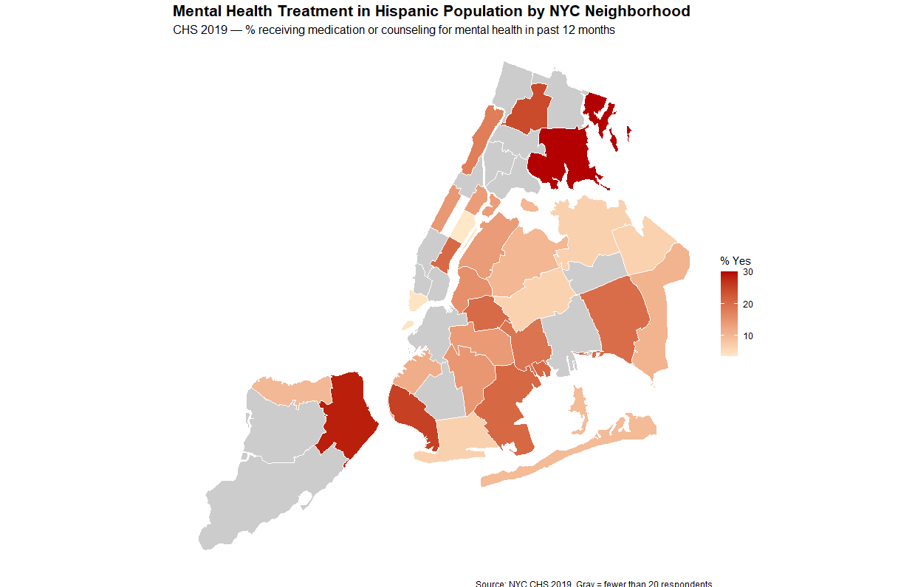
Neighborhood Most Affected:
Borough:
Bronx, Staten Island
Neighborhood:
Pelham - Throgs Neck,
Stapleton - St. George
% of Hispanic Residents Receiving Medication/Counseling for Mental Health in Last 12 months:
~30%
**UHF neighborhood codes blocked in 2020 data, 2019 data used.

Slide 13
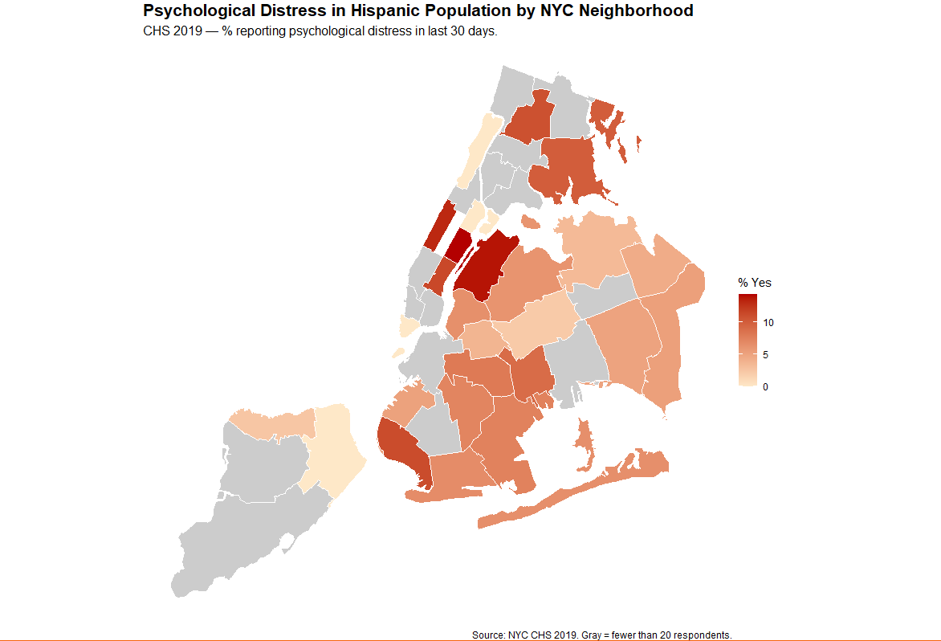
Neighborhood Most Affected:
Borough:
Manhattan, Queens
Neighborhood:
Upper East Side,
Long Island - Astoria
% of Hispanic Residents Reporting Psychological Distress in Last 30 Days:
~15%
**UHF neighborhood codes blocked in 2020 data, 2019 data used.

Slide 14
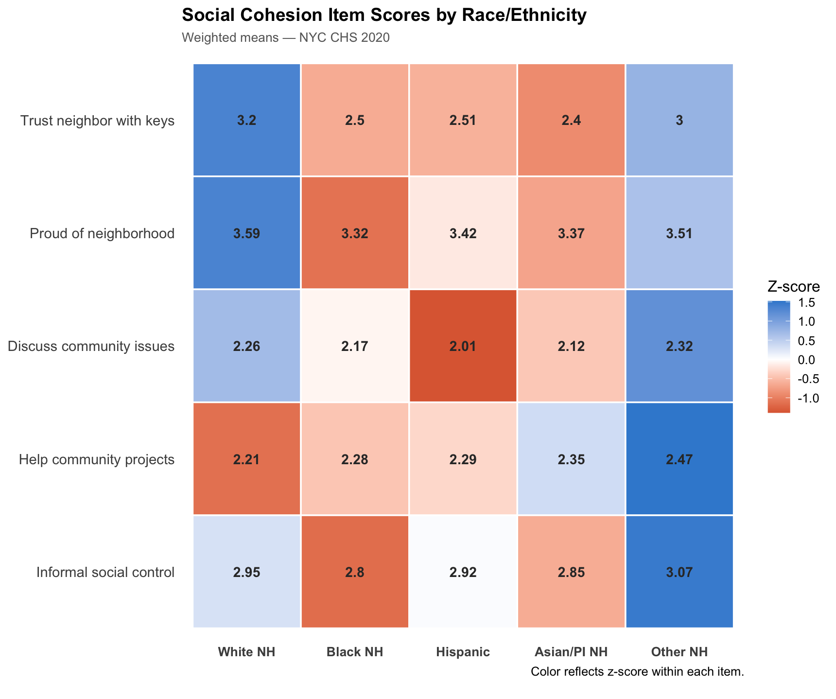
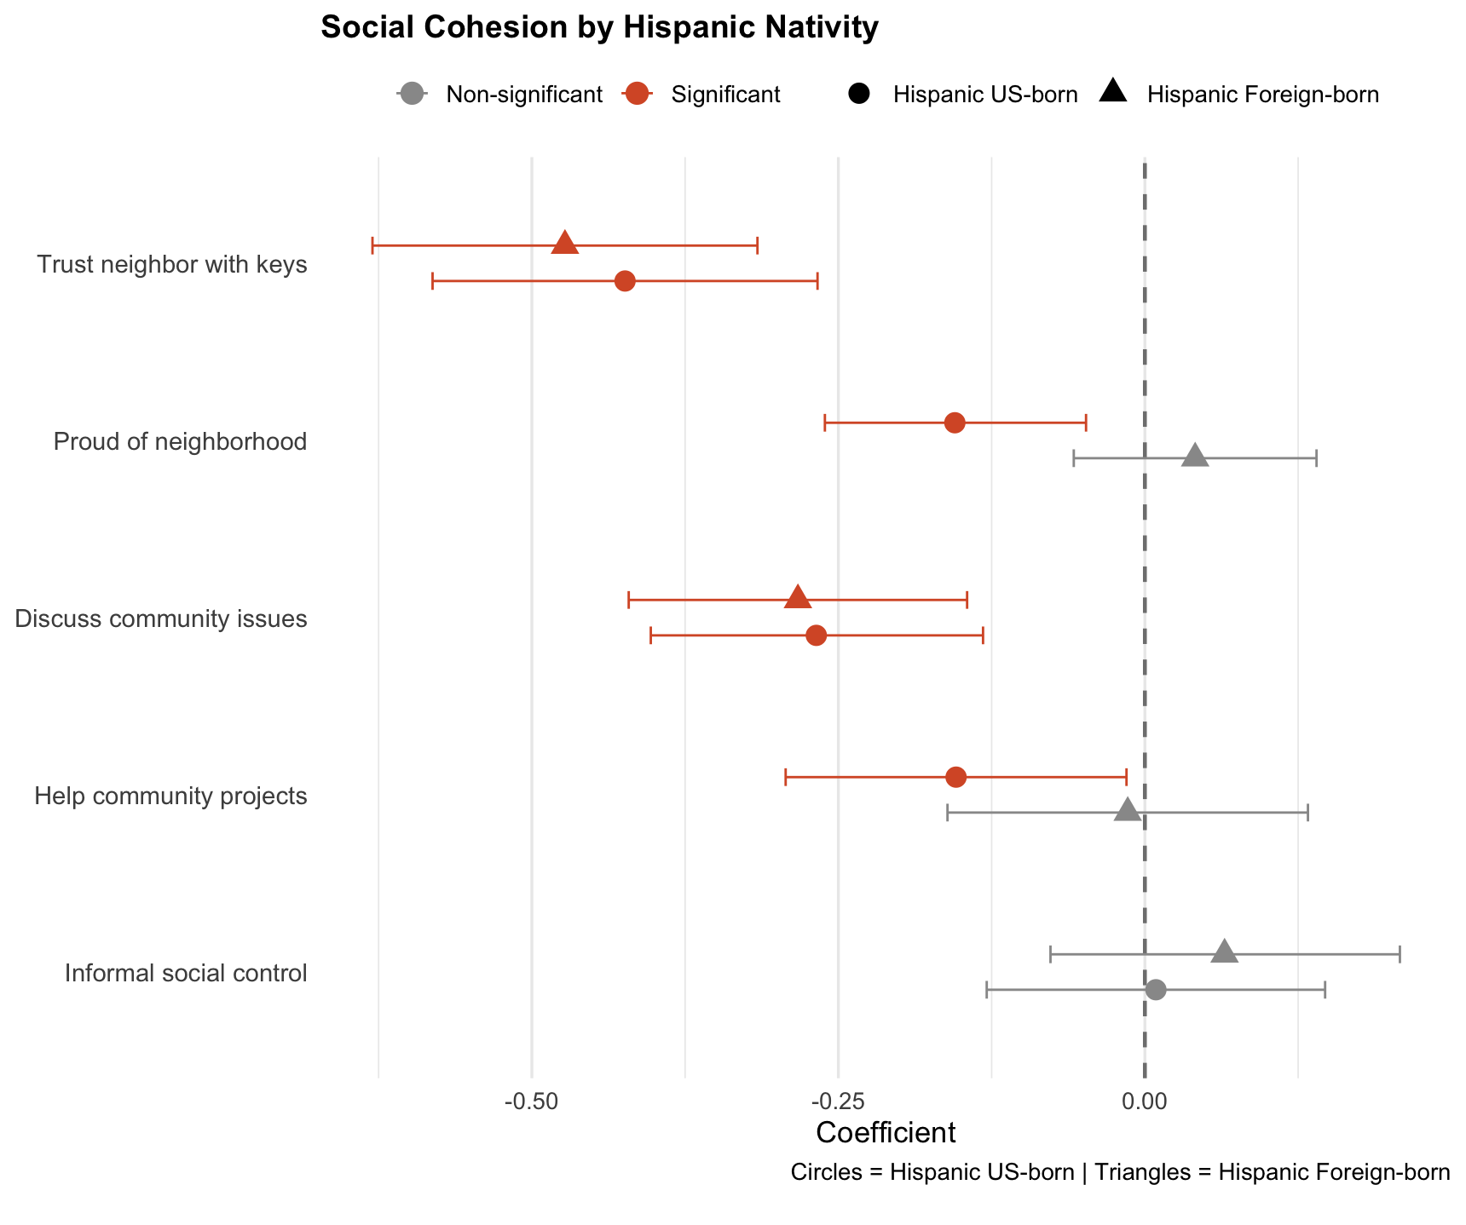
Social Health
Trust with keys:
Hispanic was significant, yet score a lower score than the baseline
Discuss community issues:
Hispanic was significant, yet scored the lowest
Proud of neighborhood:
Hispanic was not significant
Informal Social control:
Hispanic was not significant
Help community project
Hispanic was not significant
Notes:
Trust neighbor with keys, proud of neighborhood, Discuss community issues, help community projects, informed social control (if you would confront your neighbor to clean up after their dog) each variable was judged on a 1-5 on agree to disagree
Ran multiple linear regressions for each social cohesion variable.
The low scores could be do to the lack of more social variables like loneliness, social network, religious ties

Slide 15
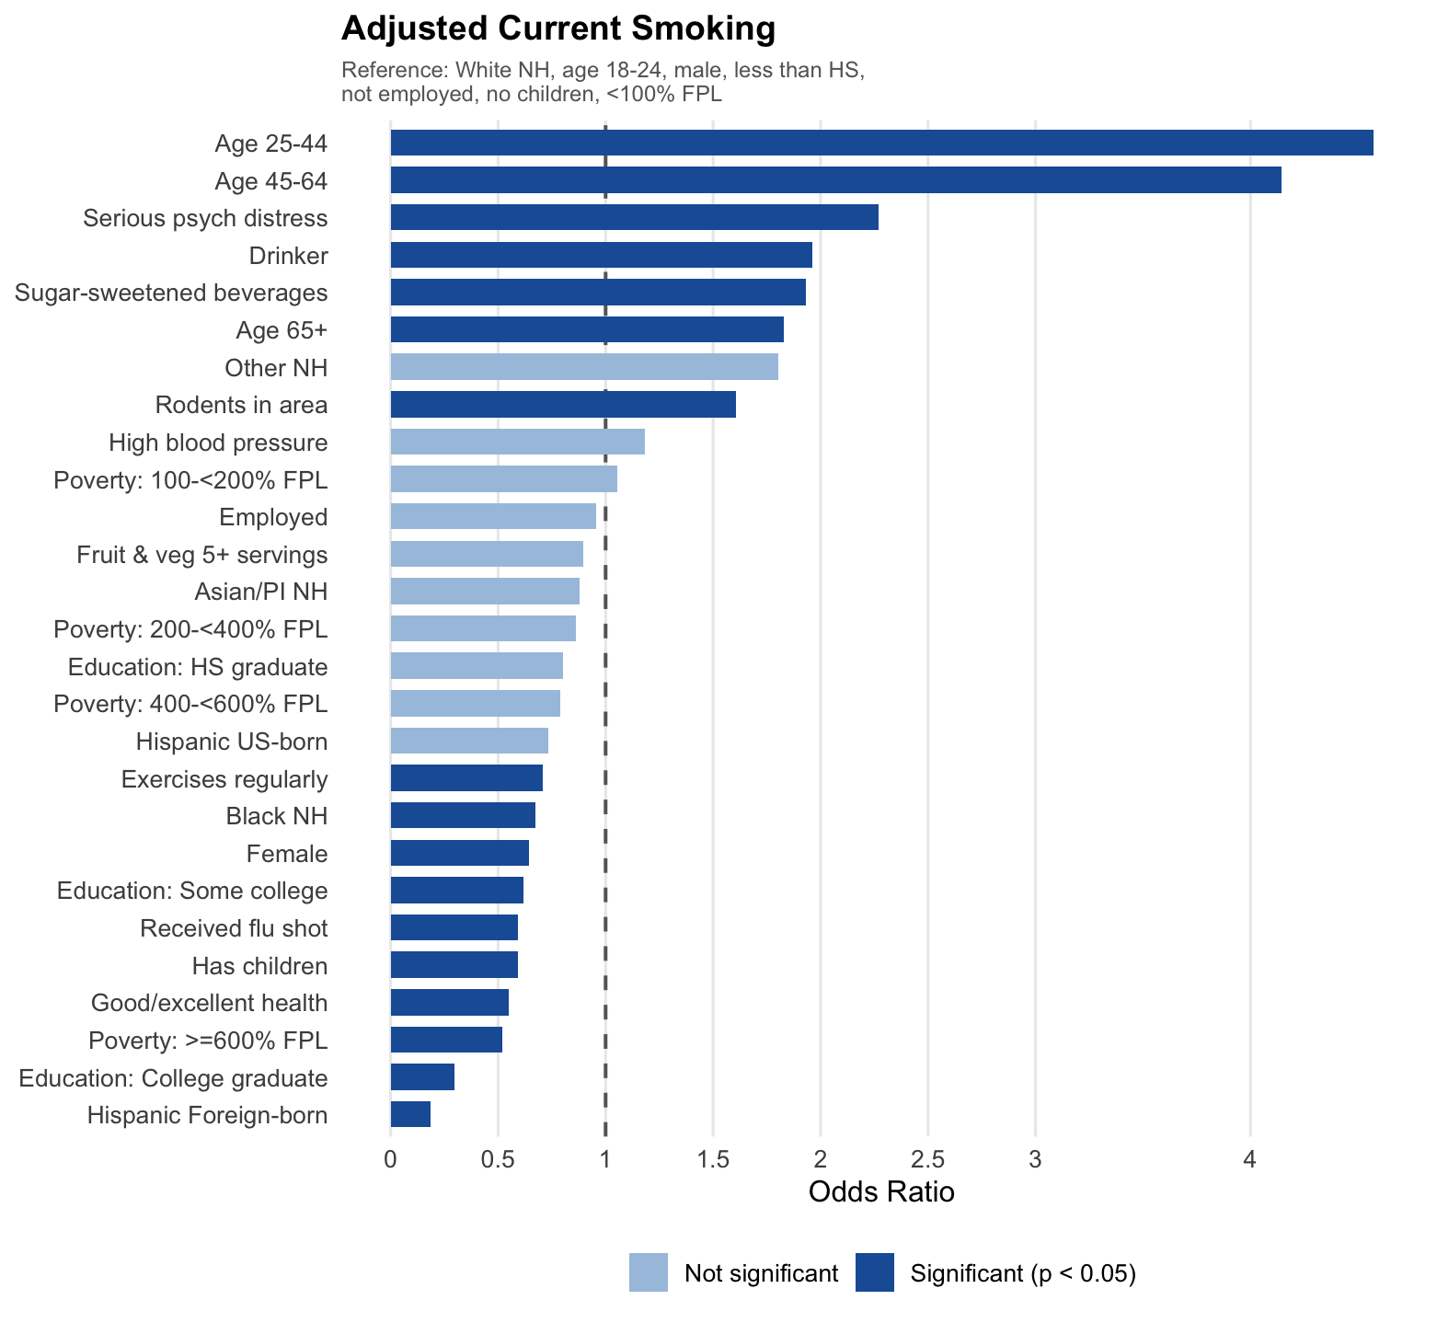
Smoking
Ages 25-44, 45-64, Serious psychological distress, and drinker were all statistically significant and the strongest predictors of current smoking
Foreign Born Hispanics had the lowest OR of smoking, meaning they are drastically less likely to smoke than the white respondent
Higher Education decreases the likeliness of smoking
Poverty, employed and Us-born hispanics was statistically insignificant from the baseline
Notes:
Predictions at reference values: age 25-44, male, high school graduate

Slide 16
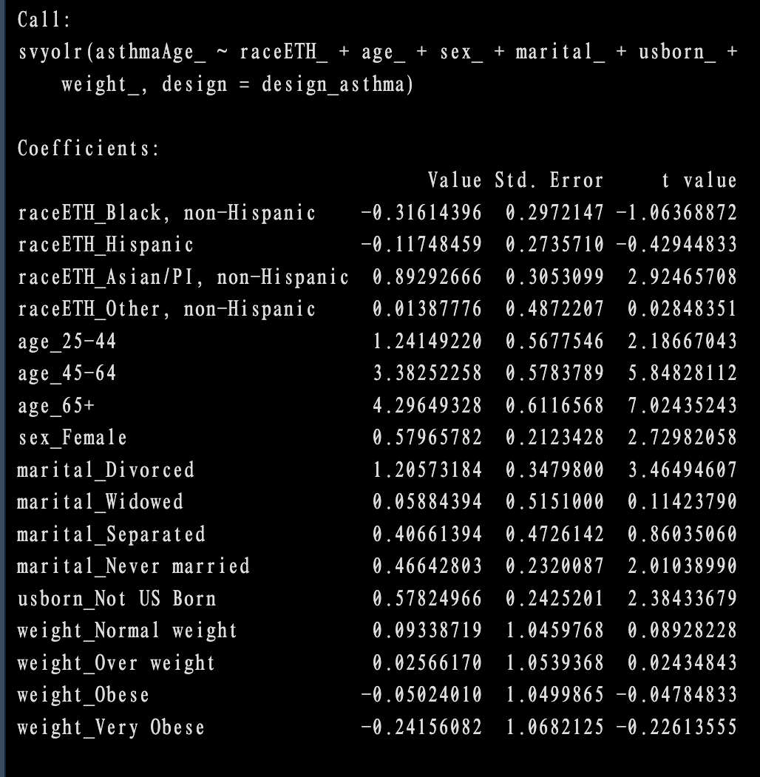
Factor Associated with Age at First Asthma Diagnosis
Method: Survey-weighted ordinal logistic regression
Hispanics did not differ significantly from White non-Hispanics in age at first asthma diagnosis
Asians/PI respondents, women, and those foreign born were more likely to be older at first asthma diagnosis compared to a White, non-Hispanic male.
Divorced and never married respondents were also diagnosed at older ages.
Weight status was not significantly associated with age at diagnosis.

Slide 17
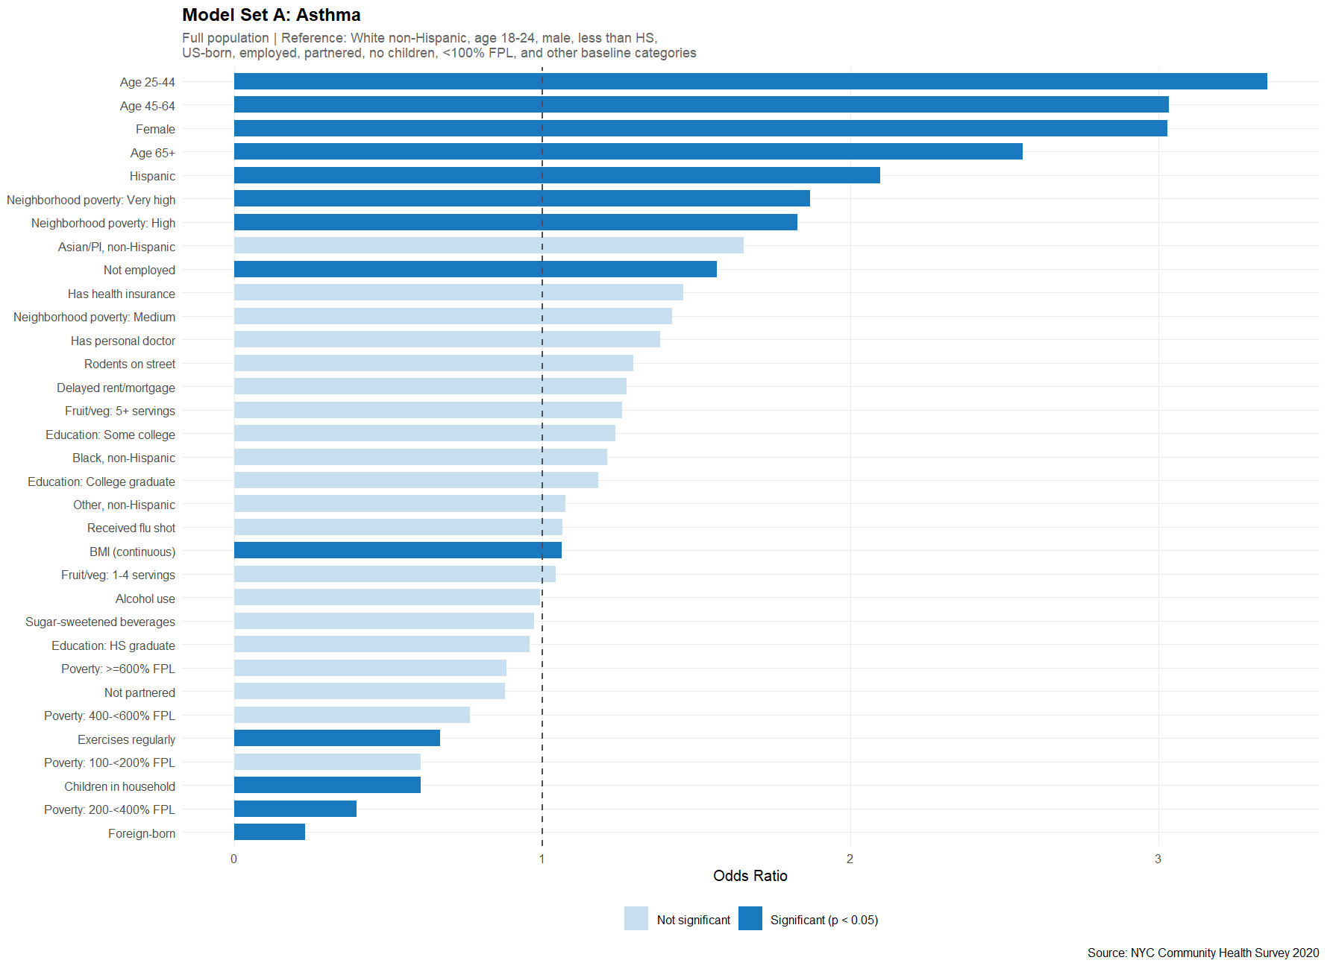
Physical Health: Asthma
Ages 45-65+ are the strongest predictors of asthma
Hispanic ethnicity and high neighborhood poverty are significantly associated with higher odds
Being foreign born and exercising are associated with lower odds of asthma
Other ethnicities were not statistically significant
Notes:
-The strongest predictors of asthma in this model were older age groups, particularly 45 and up
-Hispanic ethnicity came out as statistically significant, with higher odds of asthma compared to the White non-Hispanic baseline
-High neighborhood poverty was also associated with elevated odds
-On the opposite end, being foreign born and exercising regularly were both linked to lower odds of asthma

Slide 18
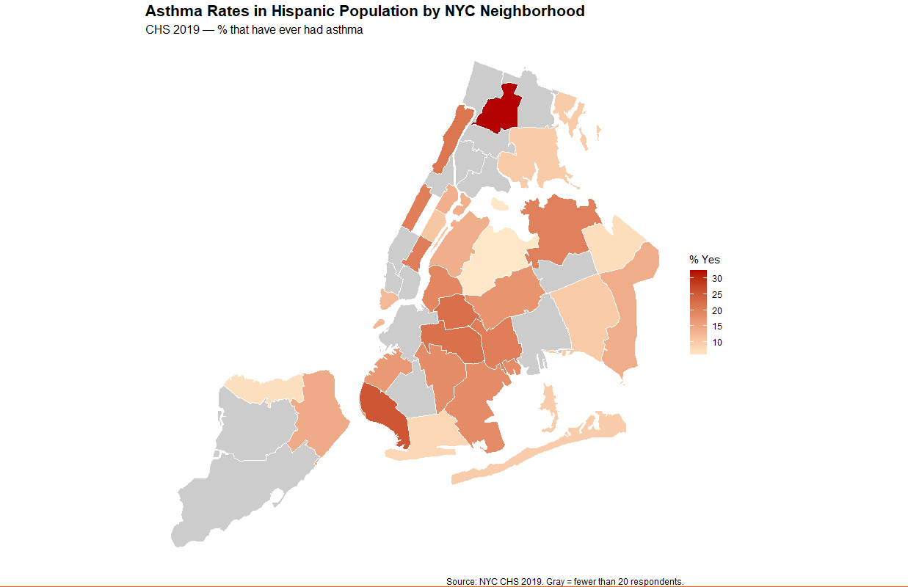
Neighborhood Most Affected:
Borough:
Bronx
Neighborhood:
Fordham - Bronx Pk.
% of Hispanic Residents Who Have Received Asthma Diagnosis:
~30%
**UHF neighborhood codes blocked in 2020 data, 2019 data used.

Slide 19
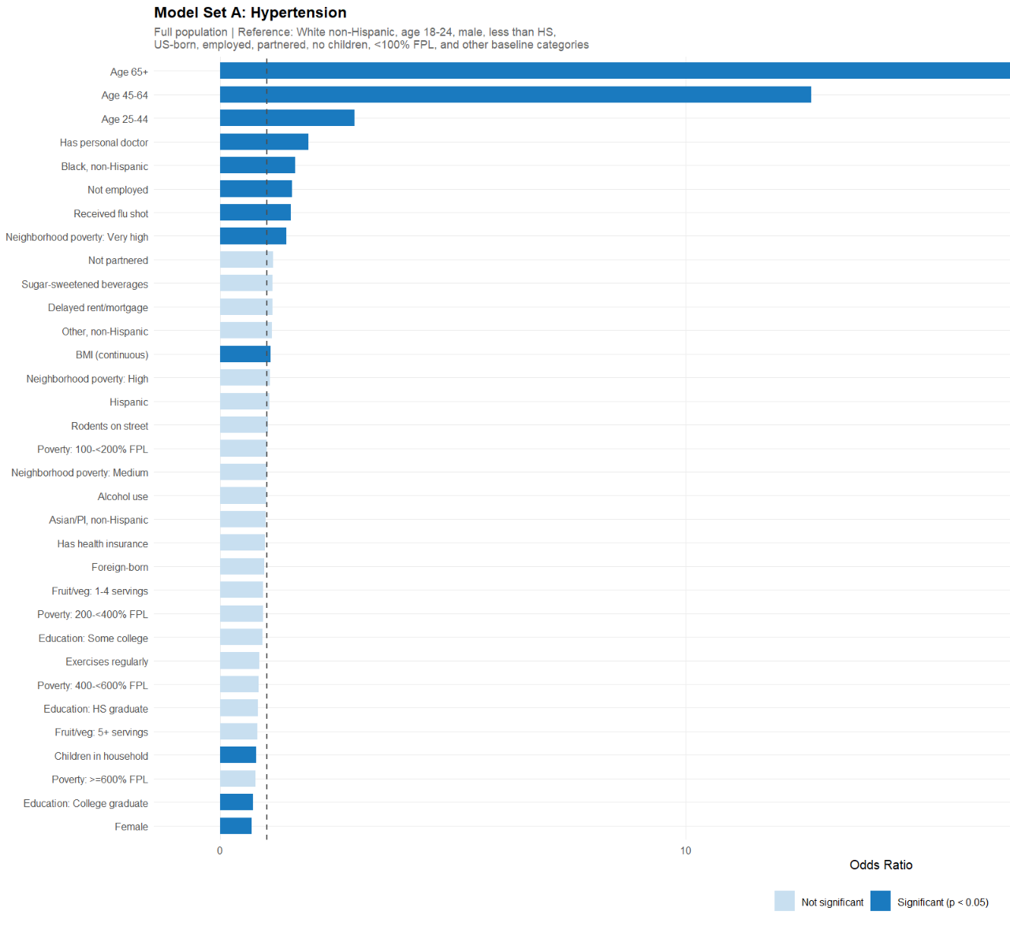
Physical Health: Hypertension
Age is the strongest predictor, specifically with ages 45-65+
Being hispanic is not statistically significant with higher blood pressure
Having a personal doctor and receiving a flu shot are associated with higher odds
Neighborhood poverty is also associated with high blood pressure, as well as being unemployed

Slide 20
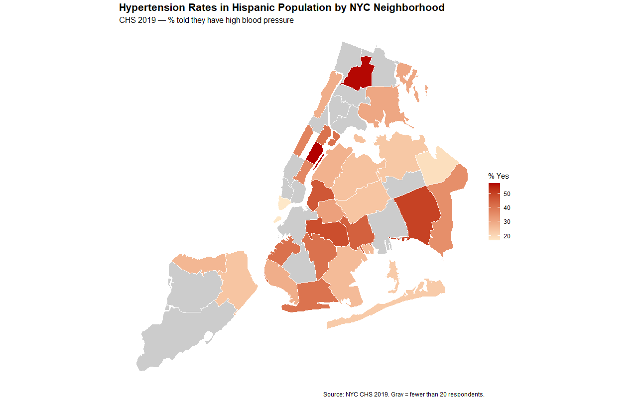
Neighborhood Most Affected:
Borough:
Bronx, Manhattan
Neighborhood:
Fordham - Bronx Pk,
Lower East Side
% of Hispanic Residents Who Have Received Hypertension Diagnosis:
~50%
**UHF neighborhood codes blocked in 2020 data, 2019 data used.

Slide 21
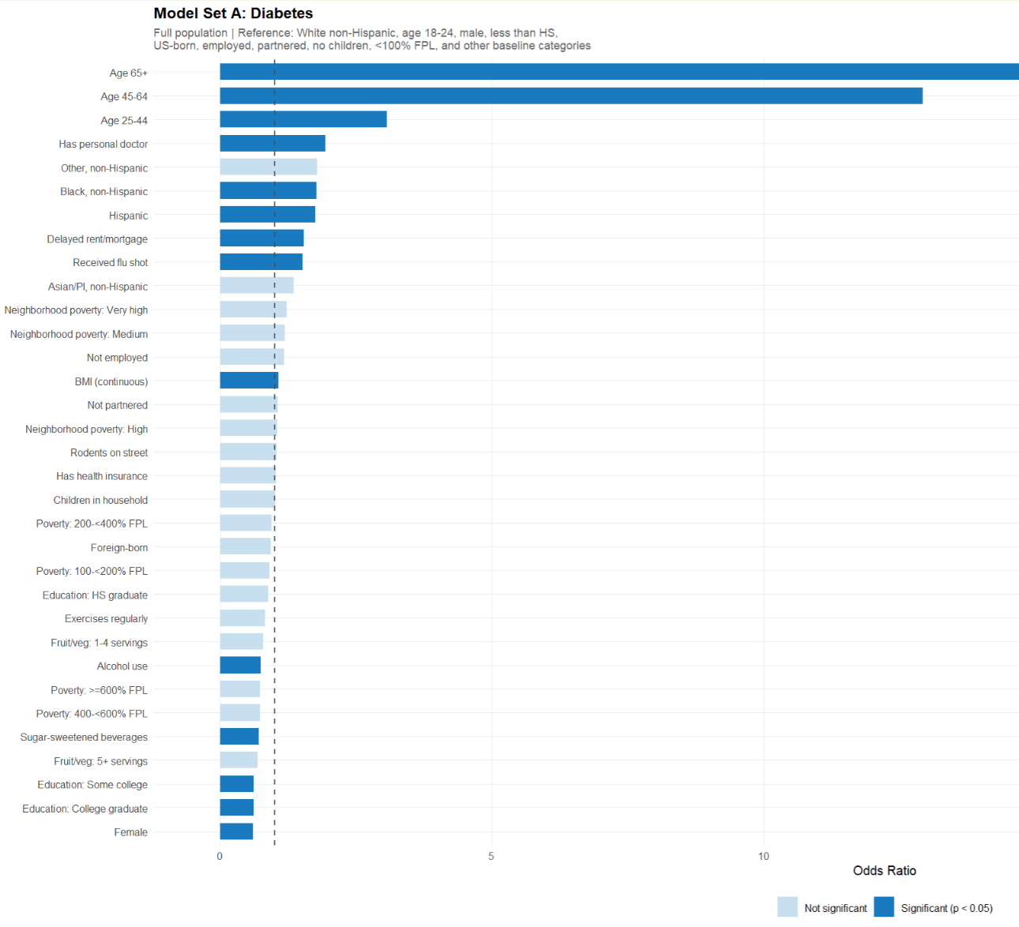
Physical Health: Diabetes
Age is the strongest predictor, with 65+ roughly ten times higher than the 18-24 reference group
Hispanic is statistically significant
BMI and alcohol use are associated with higher rates of diabetes
Most social factors such as income, neighborhood poverty, and nativity are not statistically significant
Notes:
-Age is by far the strongest predictor, with adults 65 and older showing odds roughly ten times higher than the 18 to 24 reference group
-Hispanic ethnicity is statistically significant here as well
-BMI and alcohol use are both associated with higher diabetes rates
-Notably, social and economic factors like income, neighborhood poverty, and nativity did not reach significance

Slide 22
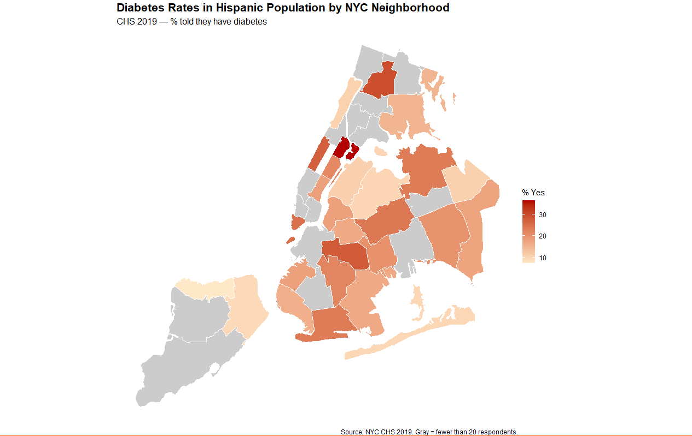
Neighborhood Most Affected:
Borough:
Manhattan
Neighborhood:
East Harlem
% of Hispanic Residents Who Have Received Diabetes Diagnosis :
~30%
**UHF neighborhood codes blocked in 2020 data, 2019 data used.

Slide 23
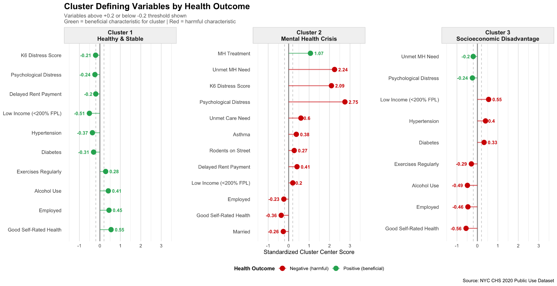
Perceived Health
Notes:
TO choose the optimal K ran an elbow and silhouette plot and chose 3
Ran Elbow and Silhouette plot to decide optimal k, extracted cluster centers, and then judged them on a ±0.2 threshold
The clusters could be summarized as
Cluster 1 : Healthy & Stable
Cluster 2: Mental Health Crisis
Cluster 3: Socioeconomic Disadvantage
The numbers in the cells are reflected by what percentage of that variable is in ie continuous variables reflected that in the clusters, while the percentages are the percentage of that variable in that cluster
sexualid_miss education_miss insured_bin pcp_bin didntgetcare_bin flushot_bin nspd_bin mhtreat_bin mhunmet_bin k6_score health_bin diabetes_bin hbp_bin asthma_bin exercise_bin drinker_bin
1 -0.142 -0.038 0.090 -0.074 -0.131 -0.095 -0.244 -0.070 -0.194 -0.210 0.547 -0.308 -0.365 -0.099 0.282 0.412
2 -0.013 -0.001 -0.035 -0.107 0.600 -0.038 2.752 1.066 2.245 2.092 -0.363 0.128 0.107 0.375 -0.145 0.094
3 0.165 0.044 -0.096 0.105 0.036 0.116 -0.244 -0.122 -0.204 -0.156 -0.555 0.327 0.397 0.042 -0.295 -0.488
fruitveg_bin ssb_bin low_income employed_bin married_bin children_bin delaypayrent_bin rodents_bin
1 0.166 -0.167 -0.514 0.446 0.109 0.000 -0.203 -0.046
2 -0.016 0.115 0.202 -0.235 -0.262 -0.119 0.409 0.274
3 -0.187 0.169 0.549 -0.464 -0.075 0.023 0.154 0.001

Slide 24
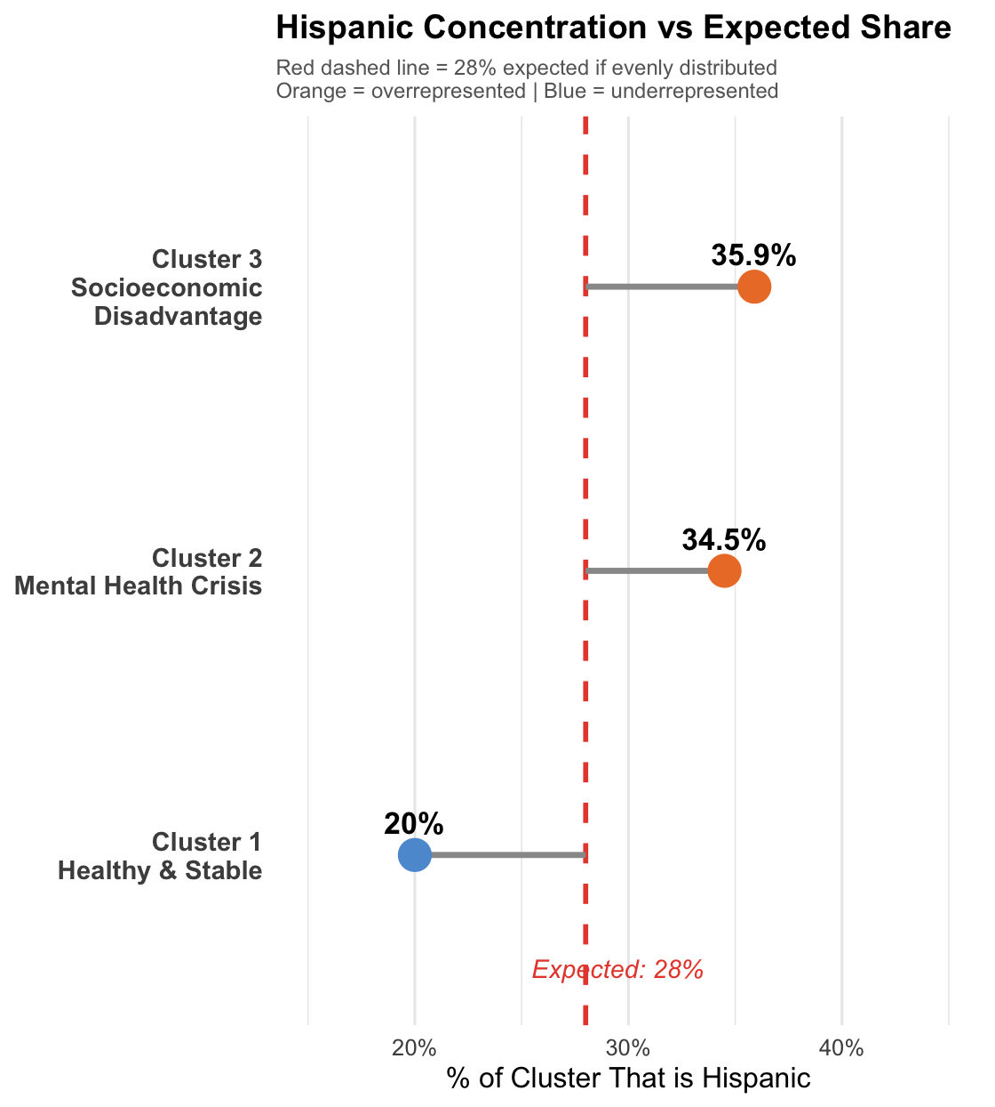
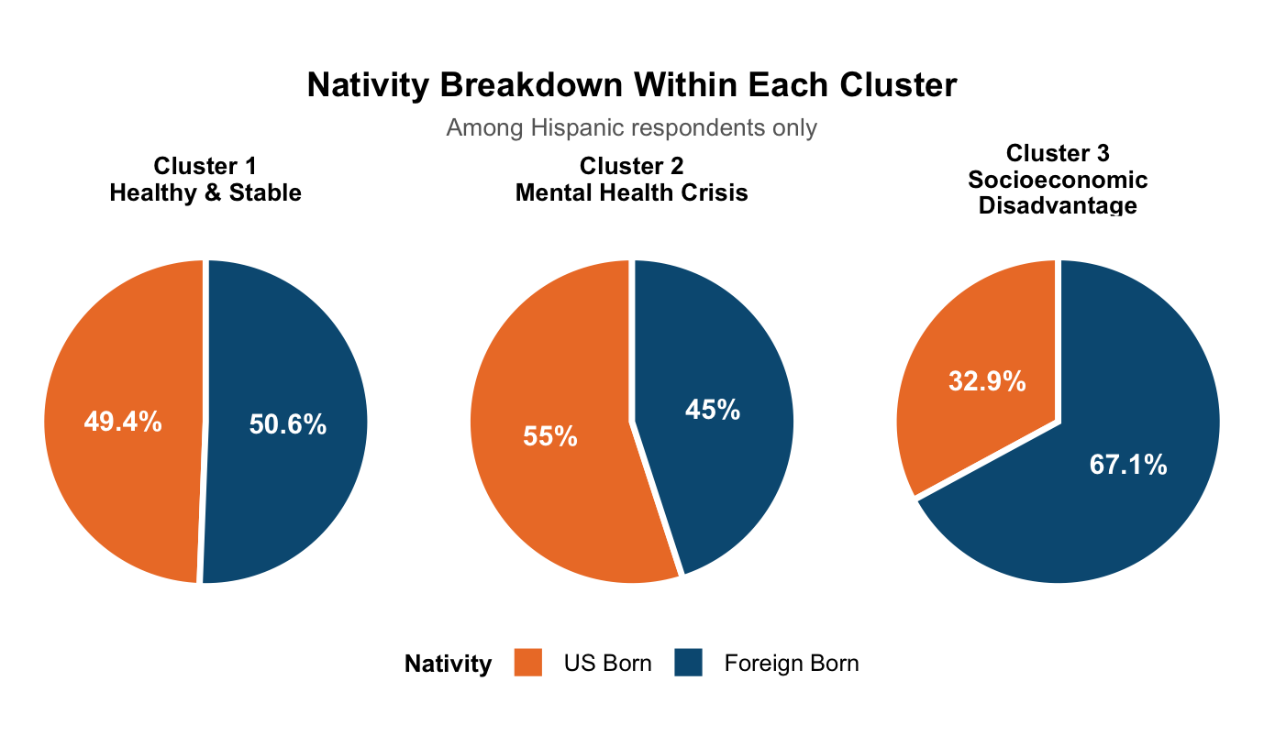
Perceived Health
The Hispanic respondents take up 28% of the survey, and of the hispanic respondents, 59.1% are foreign-born and 40.9% are US-born
Notes:
TO choose the optimal K ran an elbow and silhouette plot and chose 3
Ran Elbow and Silhouette plot to decide optimal k, extracted cluster centers, and then judged them on a ±0.2 threshold
The clusters could be summarized as
Cluster 1 : Healthy & Stable
Cluster 2: Mental Health Crisis
Cluster 3: Socioeconomic Disadvantage
The numbers in the cells are reflected by what percentage of that variable is in ie continuous variables reflected that in the clusters, while the percentages are the percentage of that variable in that cluster
sexualid_miss education_miss insured_bin pcp_bin didntgetcare_bin flushot_bin nspd_bin mhtreat_bin mhunmet_bin k6_score health_bin diabetes_bin hbp_bin asthma_bin exercise_bin drinker_bin
1 -0.142 -0.038 0.090 -0.074 -0.131 -0.095 -0.244 -0.070 -0.194 -0.210 0.547 -0.308 -0.365 -0.099 0.282 0.412
2 -0.013 -0.001 -0.035 -0.107 0.600 -0.038 2.752 1.066 2.245 2.092 -0.363 0.128 0.107 0.375 -0.145 0.094
3 0.165 0.044 -0.096 0.105 0.036 0.116 -0.244 -0.122 -0.204 -0.156 -0.555 0.327 0.397 0.042 -0.295 -0.488
fruitveg_bin ssb_bin low_income employed_bin married_bin children_bin delaypayrent_bin rodents_bin
1 0.166 -0.167 -0.514 0.446 0.109 0.000 -0.203 -0.046
2 -0.016 0.115 0.202 -0.235 -0.262 -0.119 0.409 0.274
3 -0.187 0.169 0.549 -0.464 -0.075 0.023 0.154 0.001

Slide 25
Conclusions:
Hispanics in NYC have higher odds of falling below the poverty threshold
Foreign born Hispanics show lower rates of smoking as well as psychological distress
Despite economic disadvantage, delayed medical care was not statistically significant
Hispanics have higher rates of asthma, diabetes, and hypertension with the Bronx consistently being the most affected borough
Social cohesion tended to be lower among Hispanics as well
The data reveals a Hispanic population in NYC that faces disadvantages across physical and mental health that are affected by socioeconomic factors and nativity

Slide 26
Future Improvements:
Access to more data via use agreement
More social health variables such as religious attendance, social network and loneliness scale
Demographic variables to identify the Dominican group
Mortality rate dataset for examining Hispanic paradox

Slide 27
Thank you for listening!

